Slide 1
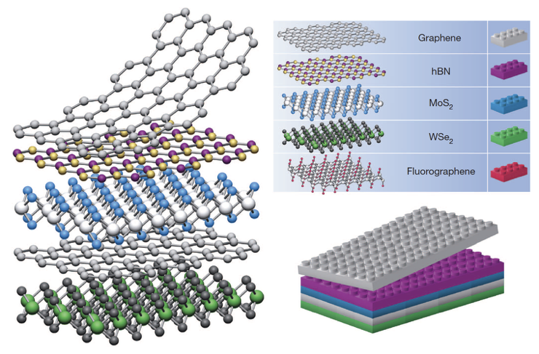
A Transition Metal Dichalcogenide Interlayer Coupling Database
S. Fang, S. Torrisi, E. Muramoto, T. Zhao

Slide 2
Overview
PROBLEM: Modeling TMDC’s from a big-compute and big-data perspective
MODEL: Material ➤ Density Functional Theory ➤ Wannier Function Generation
TOOLS/INFRASTRUCTURE: Odyssey, Spark, MapReduce
Notes:
Shiang and I are in the group of Tim Kaxiras, and we study the coupling between layers of m2d materials. The parameter space for the transition metal dichalcogenides is enormous

Slide 3
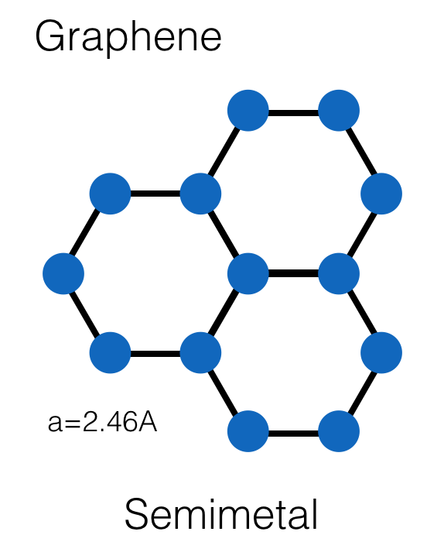
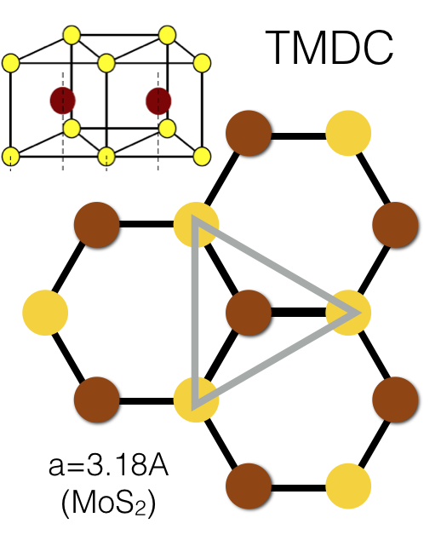
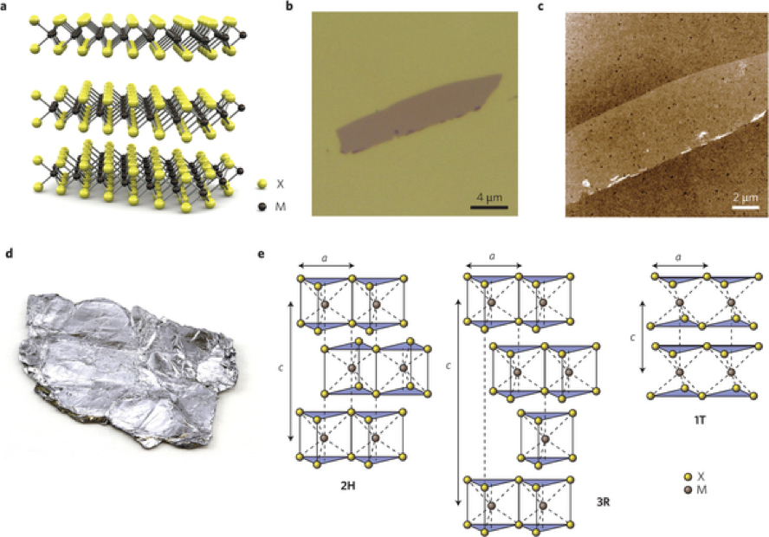
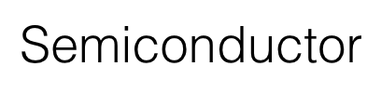
2d Materials: Transition Metal Dichalcogenides

Slide 4
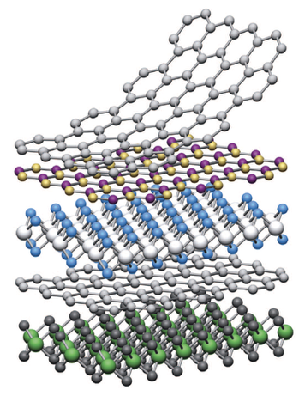
Challenges for Numerical Simulations
Goal: vdW heterostructure design / performance optimization
Various layer types
Layer stacking order
Twist angle between layers
Electrical gating
Dielectric screening
Substrate effects

Slide 5
Orbital-Orbital Interactions: Wannier Functions
Obtain orbitals for each atom,
coupling between individual
orbitals on each layer
4x Chalcogen (Sulfur): 3X p
Unit Cell
(6 atoms)
2xTransition Metal (Molybdenum): 5X d
=22 Orbitals (11 per layer)

Slide 6
Overview
PROBLEM: Modeling TMDC’s from a big-compute and big-data perspective
MODEL: Material ➤ Density Functional Theory ➤ Wannier Function Generation
TOOLS/INFRASTRUCTURE: Odyssey, Spark, MapReduce

Slide 7
Data Processing Model
Input
Splitting
Shuffling
-11 6 0 1 1 -0.000042 …
-11 6 0 2 1 0.000036 …
-11 6 0 3 1 0.000000 …
…
-10 4 0 1 1 0.000024 …
-10 4 0 2 1 -0.000041 …
-10 4 0 3 1 0.000050 …
…
-11 6 0 1 1 -0.000042 …
-10 4 0 1 1 0.000024 …
…
-11 6 0 2 1 0.000036 …
-10 4 0 2 1 -0.000041 …
…
-11 6 0 3 1 0.000000 …
-10 4 0 3 1 0.000050 …
…
-11 6 0 1 1 -0.000042 …
-11 6 0 2 1 0.000036 …
-11 6 0 3 1 0.000000 …
…
-10 4 0 1 1 0.000024 …
-10 4 0 2 1 -0.000041 …
-10 4 0 3 1 0.000050 …
…
Coordinates
(n₁ n₂ n₃ )
Orbital indices
Coupling
strength
Notes:
Data frame or RDD
Coupling strength complex number
Eri ?
Explain what is in each file – coordinates indicating the position of the orbitals, indices corresponding to orbital types, values showing coupling strength
Explain how each file is processed – splitting lines, grouping according to orbital indices
Say that we will have 400~ files, and each will be processed in this way
Turn over to Tianning?

Slide 8
Data files
-11 6 0 1 1 -0.000042 …
-11 6 0 2 1 0.000036 …
-11 6 0 3 1 0.000000 …
…
-10 4 0 1 1 0.000024 …
-10 4 0 2 1 -0.000041 …
-10 4 0 3 1 0.000050 …
…
20 × 20 cells
1
2
3
4
5
6
Coordinates
(n₁ n₂ n₃ )
Orbital indices
Coupling
strength
7
8
9
10
11
12
13
14
15
16
17
18
19
20
21
22
electronic coupling
Home Base Unit Cell
1
2
3
4
5
6
7
8
9
10
11
12
13
14
15
16
17
18
19
20
21
22
22 orbital types

Slide 9
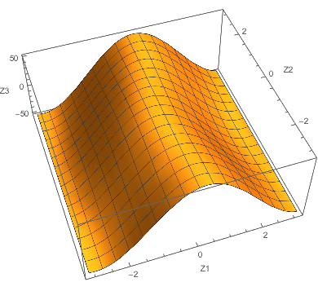
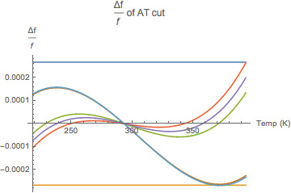
Data Processing Model
7-8 MB/file
400~ files
-11 6 0 1 1 -0.000042 …
-11 6 0 2 1 0.000036 …
-11 6 0 3 1 0.000000 …
…
-10 4 0 1 1 0.000024 …
-10 4 0 2 1 -0.000041 …
-10 4 0 3 1 0.000050 …
…
-11 6 0 1 1 -0.000042 …
-10 4 0 1 1 0.000024 …
…
-11 6 0 2 1 0.000036 …
-10 4 0 2 1 -0.000041 …
…
-11 6 0 3 1 0.000000 …
-10 4 0 3 1 0.000050 …
…
Final Results
-11 6 0 1 1 -0.000042 …
-11 6 0 2 1 0.000036 …
-11 6 0 3 1 0.000000 …
…
-10 4 0 1 1 0.000024 …
-10 4 0 2 1 -0.000041 …
-10 4 0 3 1 0.000050 …
…
-11 6 0 1 1 -0.000042 …
-10 4 0 1 1 0.000024 …
…
-11 6 0 1 1 a …
-10 4 0 1 1 d …
…
-11 6 0 1 1 g …
-10 4 0 1 1 j …
…
-11 6 0 2 1 0.000036 …
-10 4 0 2 1 -0.000041 …
…
-11 6 0 2 1 b …
-10 4 0 2 1 e …
…
-11 6 0 2 1 h …
-10 4 0 2 1 k …
…
-11 6 0 3 1 0.000000 …
-10 4 0 3 1 0.000050 …
…
-11 6 0 3 1 c …
-10 4 0 3 1 f …
…
-11 6 0 3 1 i …
-10 4 0 3 1 l …
…
-11 6 0 1 1 a …
-11 6 0 2 1 b …
-11 6 0 3 1 c …
…
-10 4 0 1 1 d …
-10 4 0 2 1 e …
-10 4 0 3 1 f …
…
-11 6 0 1 1 a …
-10 4 0 1 1 d …
…
-11 6 0 2 1 b …
-10 4 0 2 1 e …
…
-11 6 0 3 1 c …
-10 4 0 3 1 f …
…
-11 6 0 1 1 a …
-11 6 0 2 1 b …
-11 6 0 3 1 c …
…
-10 4 0 1 1 d …
-10 4 0 2 1 e …
-10 4 0 3 1 f …
…
-11 6 0 1 1 g …
-11 6 0 2 1 h …
-11 6 0 3 1 i …
…
-10 4 0 1 1 j …
-10 4 0 2 1 k …
-10 4 0 3 1 l …
…
-11 6 0 1 1 g …
-10 4 0 1 1 j …
…
-11 6 0 2 1 h …
-10 4 0 2 1 k …
…
-11 6 0 3 1 i …
-10 4 0 3 1 l …
…
-11 6 0 1 1 g …
-11 6 0 2 1 h …
-11 6 0 3 1 i …
…
-10 4 0 1 1 j …
-10 4 0 2 1 k …
-10 4 0 3 1 l …
…
Tools and Infrastructure :
Odysssey, Spark, MPI
Notes:
Tianning?
Explain how spark, MPI will be used to process 400~ files?

Slide 10
Overview
PROBLEM: Modeling TMDC’s from a big-compute and big-data perspective
MODEL: Material ➤ Density Functional Theory ➤ Wannier Function Generation
TOOLS/INFRASTRUCTURE: Odyssey, Spark, MapReduce

Slide 11
Details about Implementation
Datasets combination
(400 files → 1 RDD)
RDD transformation
Parallel computing
Based on MPI
-11 6 0 1 1 -0.000042 …
-10 4 0 1 1 0.000024 …
…
-11 6 0 2 1 0.000036 …
-10 4 0 2 1 -0.000041 …
…
-11 6 0 3 1 0.000000 …
-10 4 0 3 1 0.000050 …
…
Visualize Output
Perform further calculations
(electronic, mechanical)
Generate Orbital-Based Pseudopotentials/Reference Map
-11 6 0 1 1 -0.000042 …
-11 6 0 2 1 0.000036 …
-11 6 0 3 1 0.000000 …
…
-10 4 0 1 1 0.000024 …
-10 4 0 2 1 -0.000041 …
-10 4 0 3 1 0.000050 …
…
Coordinates
(n₁ n₂ n₃ )
Orbital indices
Coupling
strength
Notes:
Eri: explain what is in each file and why 400 of them
Tianning: explain the workflow shown above

Slide 12
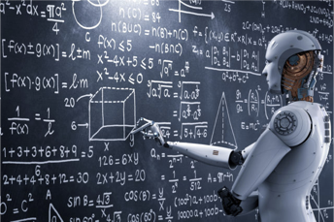
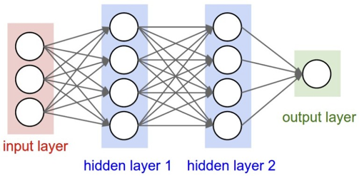
Outlook: Analysis and Learning
Big database for various:
Atomic species
Orbitals types
Symmetry and geometry
Bonding vectors
CDW deformations / strains / pressure on crystals / relaxations
Phases (magnetic, topological, etc.)
Substrates
Learning targets
Coupling strength
Intralayer corrections

Slide 13
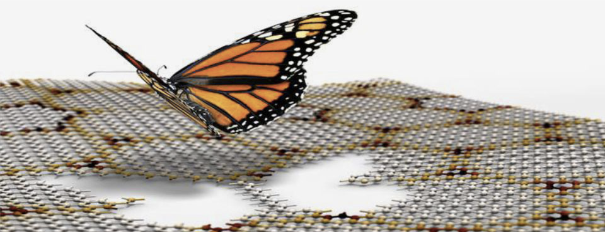
Questions?

